Slide 1
Sunnah QA
Building a Question Answering System for Sunnah

Slide 2
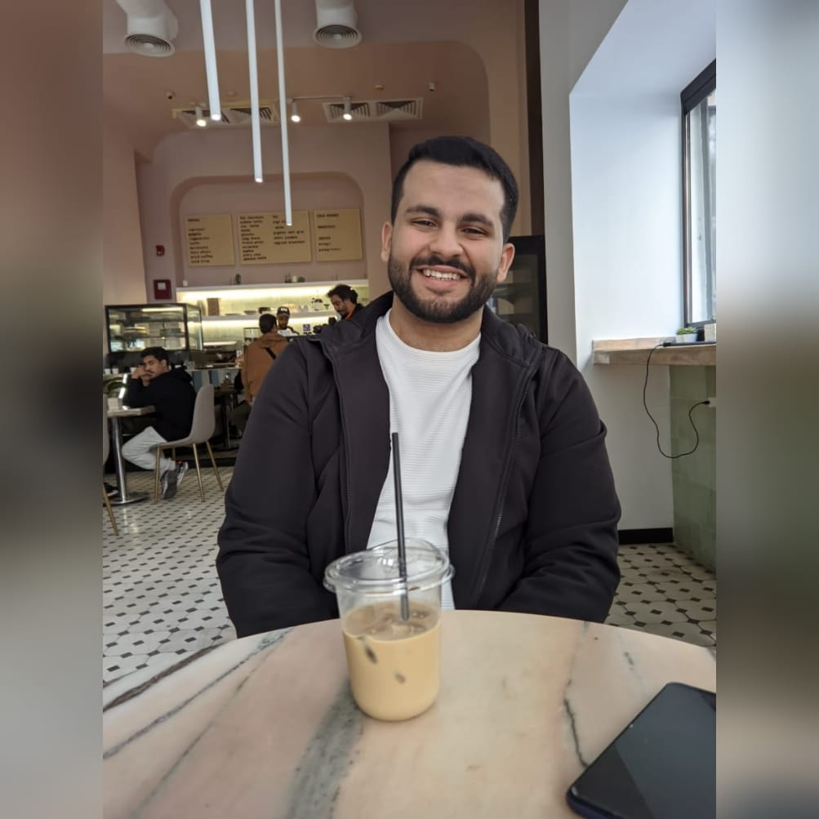


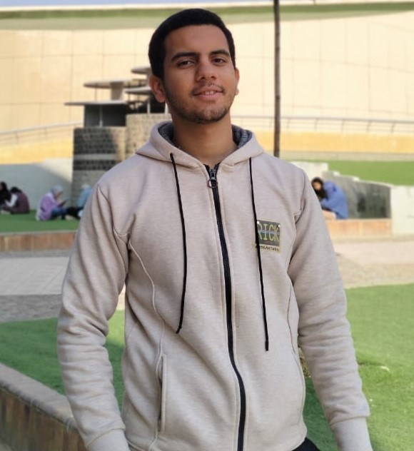

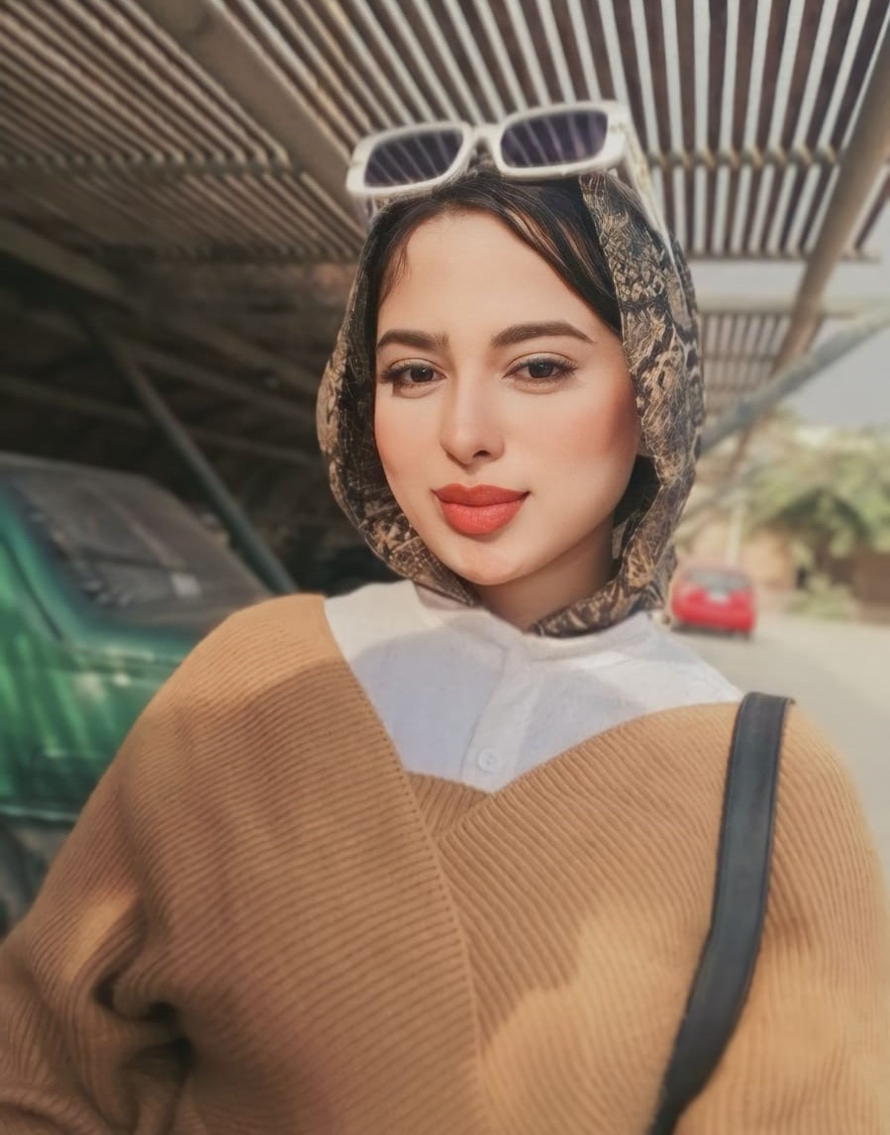
Team
Mohammed Ashraf
Mohammed Maher
Mohammed Zakaria
Ahmer Ashraf
Mostafa Kamal
Marwa Asaad

Slide 3
Content
4-9
Introduction
RAG Model
19-26
10-14
Hadith QA: Data Collection
Hadith Authenticator
27-36
15-18
37-42
Transformers Model
Deployment

Slide 4






Introduction
Cornerstone of Islamic Scholarship: Sunnah, the sayings and practices of Prophet Muhammad (PBUH), are essential for Islamic study and practice.
Manual Retrieval Challenges: Traditional Hadith retrieval methods are time-consuming and resource-intensive
Digital Transformation: The digital age has made online Hadith resources more available, supporting advanced retrieval systems.
NLP Techniques : (NLP) automates and improves retrieval by addressing concise language and context understanding.
Project Aim : This project aims to develop an advanced Hadith QA and retrieval system, enhancing accessibility and efficiency.

Slide 5



Problem Statement
Current inaccuracies force people to rely on reading books to get the Islamic knowledge, instead of easily accessing specific, reliable answers to their questions digitally.
Current Hadith retrieval systems lack specificity, causing the spread of inaccurate information within the Islamic community.
Large Language Models (LLMs) often provide incorrect Hadith information, leading to potential misunderstandings of Islamic teachings.

Slide 6







Motivation
Critical Need of Accurate Hadith Information Retrieval
Support and aid scholars, students, and practitioners and improve research efficiency
Improve accuracy and reliability of Hadith retrieval
Enhanced accessibility to authentic Hadith knowledge
Academic contribution for Islamic studies and preserving Islamic knowledge
Community empowerment and provide trustworthy information.
Notes:
Critical need of accurate Hadith information retrieval
Improve accuracy and reliability of Hadith retrieval
Enhanced accessibility to authentic Hadith knowledge
Support and aid scholars, students, and practitioners and improve research efficiency
Academic contribution for Islamic studies and preserving Islamic knowledge
Community empowerment and provide trustworthy information.

Slide 7




Objectives
Our Project Aims to:
Provide Accurate Hadith Information
01
Real-Time Responses
02
Verify Hadith Authenticity
03
User-Friendly Interface
04
05
Contextual Understanding
Notes:
Provide Accurate Hadith Information: Develop a chat application that allows users to ask questions about Hadiths and receive accurate, contextually relevant answers from a reliable database.
User-Friendly Interface: Design a user interface that is intuitive and accessible, allowing users to easily query and navigate through the information.
Contextual Understanding: Ensure the app provides not just the text of Hadiths but also explanations, contexts, and interpretations from credible sources.
Real-Time Responses: Implement a system that offers real-time answers to user queries, making the information readily available.
Verify Authenticity: Create a tool that independently verifies the authenticity of Hadiths by cross-referencing with established Hadith collections and scholarly works.
Detailed Verification Reports: Provide detailed reports on the authenticity of Hadiths, including the chain of narration (Isnad), text (Matn), and scholarly opinions.
Database Integration: Maintain a comprehensive and regularly updated database of Hadiths, categorized by their authenticity (e.g., Sahih, Da'if, Hasan).

Slide 8


Presentation Content
Hadith Chatbot
Hadith Classification

Slide 9

Why Estedlal App idea
1
User-Friendly Interface
Easy for everyone to use. It has simple design, so even if you're not good with technology, you can still use it.
2
Real-Time Interaction
Responds right away, like talking to a person. It's quick and feels like a real conversation, keeping you engaged.
3
Conversational Memory
keeps track of your previous questions and answers in a database. So if you want to recall something you asked before, it's there for you.

Slide 10
Related Work
Paper Title | Paper Summary
DTW at Qur’an QA 2022: Utilising Transfer Learning with Transformers for Question Answering in a Low-resource Domain | Uses transfer learning with transformers to improve question answering in a low-resource domain.
HAQA and QUQA: Constructing two Arabic Question-Answering Corpora for the Quran and Hadith | Introduces HAQA and QUQA corpora, the first for Hadith and the latter for the Quran, aiding Arabic QA research.
Low-Resource Machine Reading Comprehension: A Comprehensive Survey | Reviews techniques and challenges in low-resource machine reading comprehension.
Retrieval-Augmented Generation for Knowledge-Intensive NLP Tasks | Introduces RAG, combining retrieval and generation to enhance performance on knowledge-intensive tasks.

Slide 11
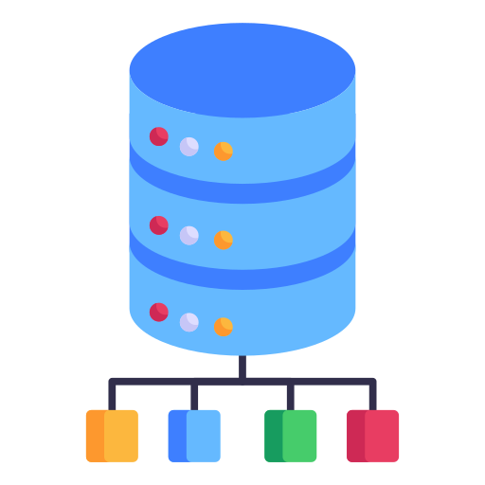
HAQA Dataset
This dataset is designed for a QA system and includes additional information that is not beneficial for our current needs. We have extracted and customized the necessary data from it.
Key sources: HAQA and QUQA: Constructing two Arabic Question-Answering Corpora for the Quran and Hadith
Notes:
[] Deletable sections here

Slide 12




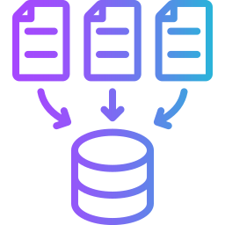


Hadith QA RAG
Data Collection
Rename these columns to 'question', 'context', and 'answers'.
Incorporating the answer start within the context.
Extract the following columns: 'Question_Text', 'Hadith_Matn', and 'Answer-Instances'.
Data Preprocessing.
The dataset consisted of 1595 rows. After removing rows with no answers, we were left with 1594 rows.
Now it is ready for work on.

Slide 13
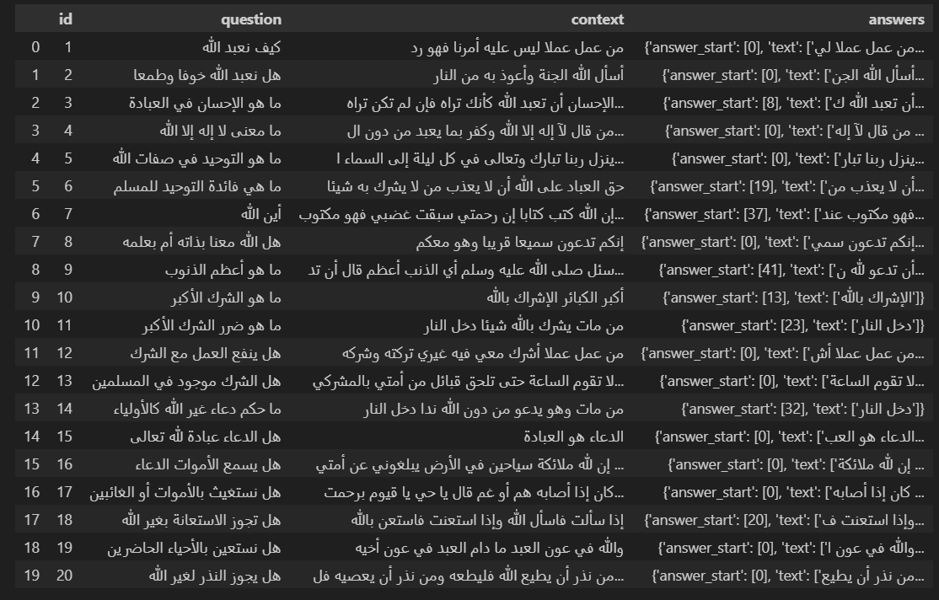
Dataset Head

Slide 14
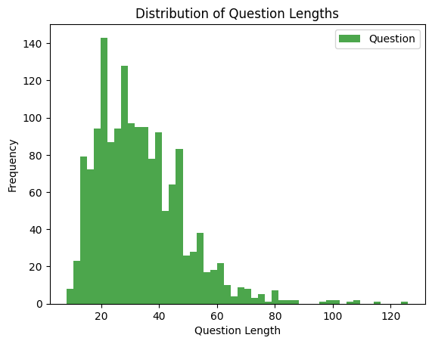
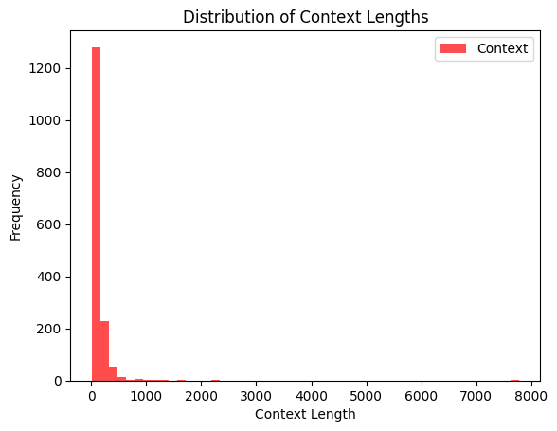
Dataset Distribution
distribution of question lengths. We observe that the maximum question length is 126 characters.
distribution of context lengths within our dataset. The maximum context length observed is 7777 characters

Slide 15
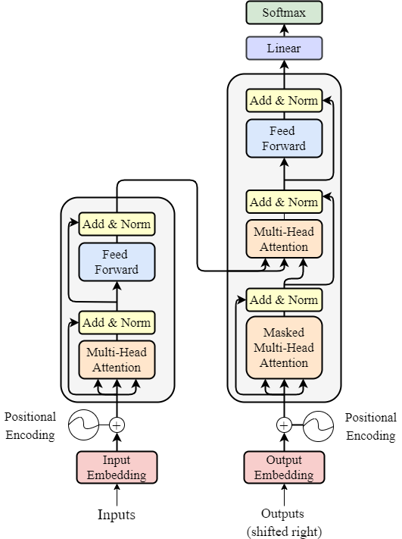
Transformers
Transformers play a crucial role in Question-Answering (QA) tasks, where they analyze questions and provide accurate answers by understanding context and relationships within text data.

Slide 16
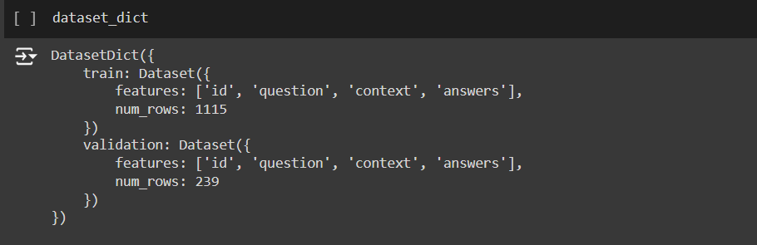
Data Format
Transformers QA Data Format:
We will transform the data into Dataset Object
Note: For Transformers we divided the data into 70% for training, 15% for validation, and 15% for testing.

Slide 17
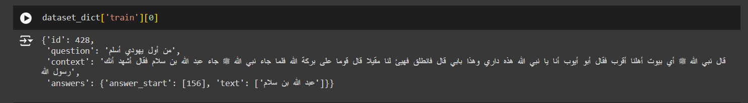
Data Sample
Here is a sample from the training data:

Slide 18
Existing Results
Model | EM | F1 | Precision | Recall
AraElectra | 61.25 | 82.10 | 62.08 | 62.08
AraBert | 35.83 | 65.52 | 35.83 | 35.83
mbert-cased | 44.58 | 72.57 | 45.0 | 45.0
RoBERTa | 49.58 | 77.58 | 13.0 | 13.0
Although there are no specific Hadith retrieval systems, our trial of transformer models for Question-Answering (QA) tasks provided valuable insights.
Note: AraElectra outperformed other transformer models, highlighting its effectiveness in Arabic language tasks.

Slide 19
Transformers Problems
Utilizing transformers highlighted two primary issues:
Context-Question Mismatch
In scenarios where the answer isn't present in the context, transformers lack the ability to generate responses, resulting in significant constraints on the system's functionality.
Users need to enter both the question and the Hadith (context), but the answer should already be in the provided context. This requirement can be confusing and doesn't always align with how questions are typically asked.
Limited Context Utilization

Slide 20

RAG
What is the RAG ?
- Rag stands for "Retrieval-Augmented Generation." It's a technique that combines retrieval-based methods with generative models to enhance the quality of generated text.

Slide 21



RAG
Why Rag ?
Reduced Hallucination
RAG helps mitigate hallucination, a common issue in language generation models, by incorporating information from retrieved sources, leading to more grounded and factually accurate responses.
Contextual Understanding
It leverages large knowledge sources to better understand and incorporate context, resulting in more accurate and contextually relevant text generation
Mitigation of Limitations
RAG addresses the limitations of traditional generative models by combining retrieval-based techniques, offering a more robust solution for generating high-quality text across diverse contexts.

Slide 22
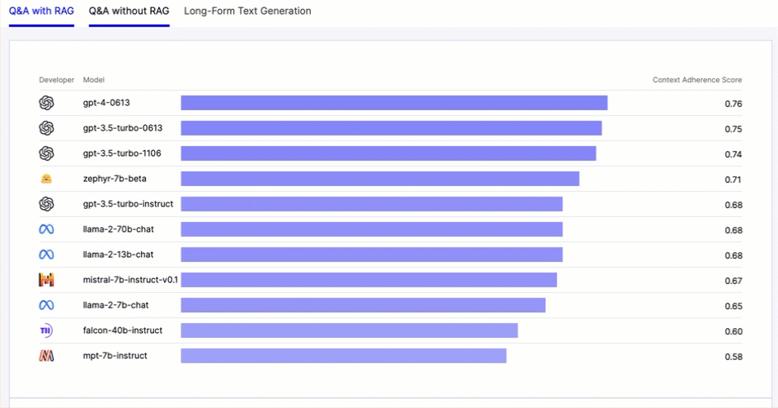
LLM Hallucination
However, Rag, with its tailored LLM for Hadith data, addresses this limitation by dynamically generating answers. This reduce issues like hallucination and ensures accurate responses even for novel topics. Empirical experiments confirm Rag's superiority over traditional models, consistently delivering optimized answers.

Slide 23
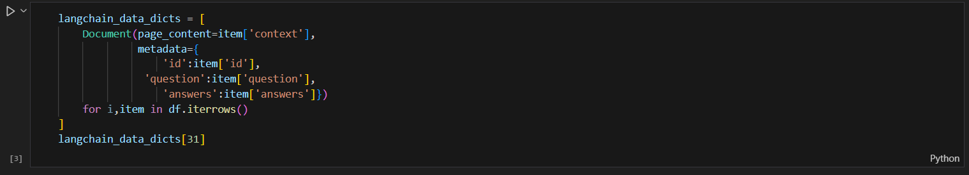
Data Format
Rag QA Data Format:
We will transform the data into Document Object

Slide 24
Rag Components
This combination of cloud storage and advanced LLMs allows us to create a powerful and efficient RAG system.
Large Language Model (LLM)
The LLM generates the answers based on the retrieved data.
Initially, we used ChatGPT Turbo 3.5 for this task.
Due to some issues with the free API, we switched to using the LLM Gemini-1.5-flash-latest for generating responses.
Cloud Storage and Retrieval
- We use the cloud to store and retrieve data efficiently.
- Specifically, we utilized QDrant Cloud for this purpose. It helps us manage large - Volumes of data and ensures quick access when needed.

Slide 25
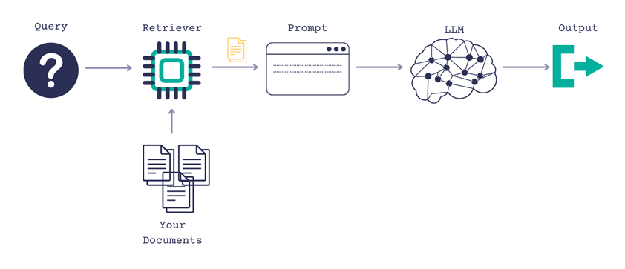
Functionality
How Does Rag Work?

Slide 26
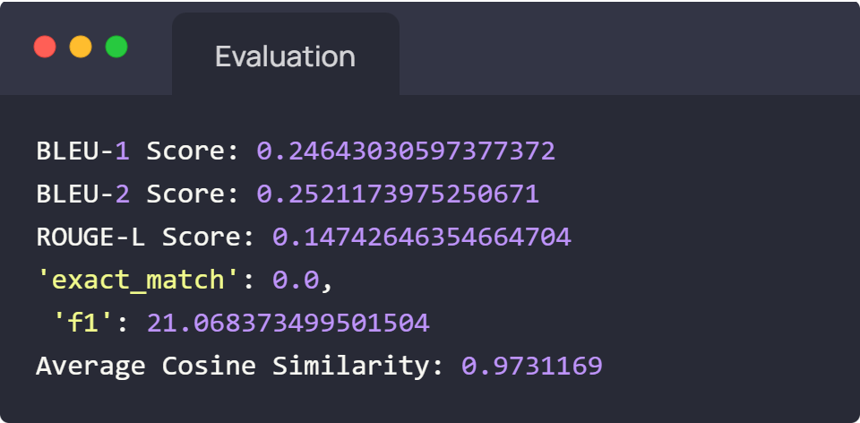
Final Results
A survey was conducted with 50 participants, Participants rated the perceived truthfulness of the generated responses on a scale of 1 to 10 and the average rating was 81.14%.

Slide 27
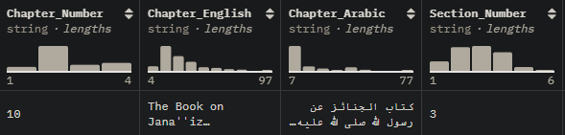
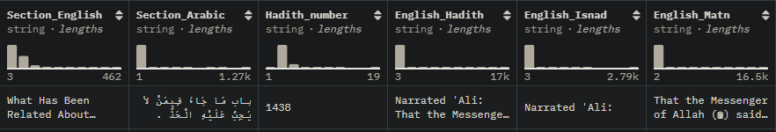
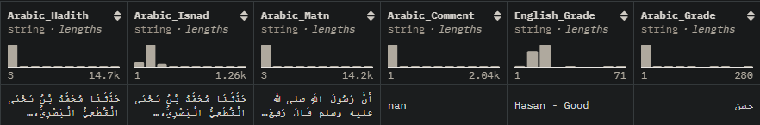
Hadith Classification
Hadith Verification Dataset Schema

Slide 28
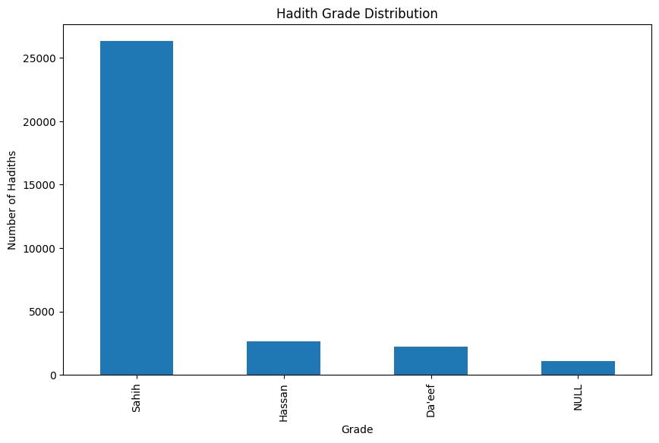
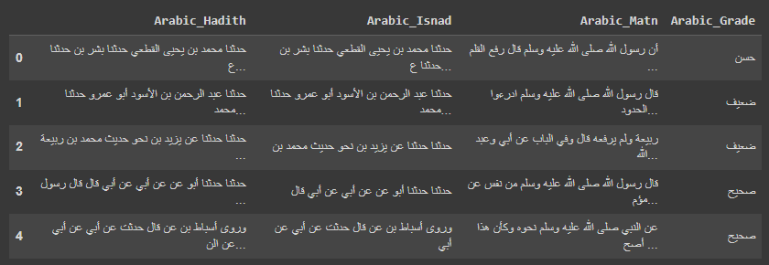
Hadith Classification
Hadith Grade Distribution
Preprocessed dataset we used in Hadith Authenticator

Slide 29
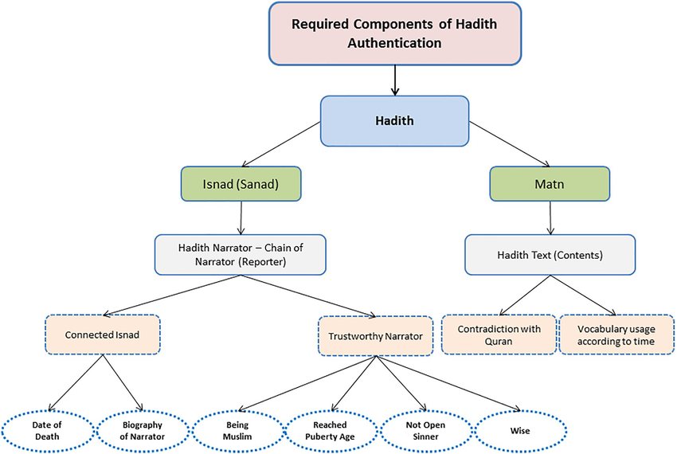
Hadith Process

Slide 30
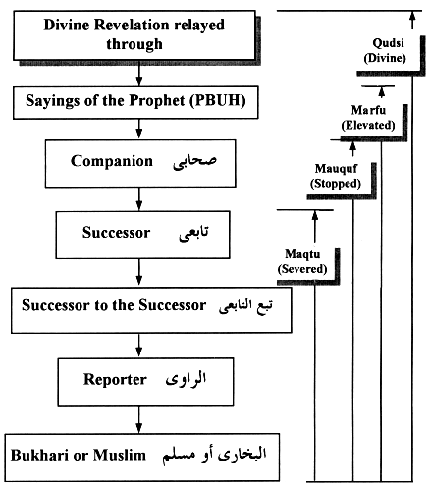
Authentic books
صحيح البخاري
صحيح مسلم
سنن النسائي
سنن أبي داود
سنن الترمذي
سنن ابن ماجه

Slide 31
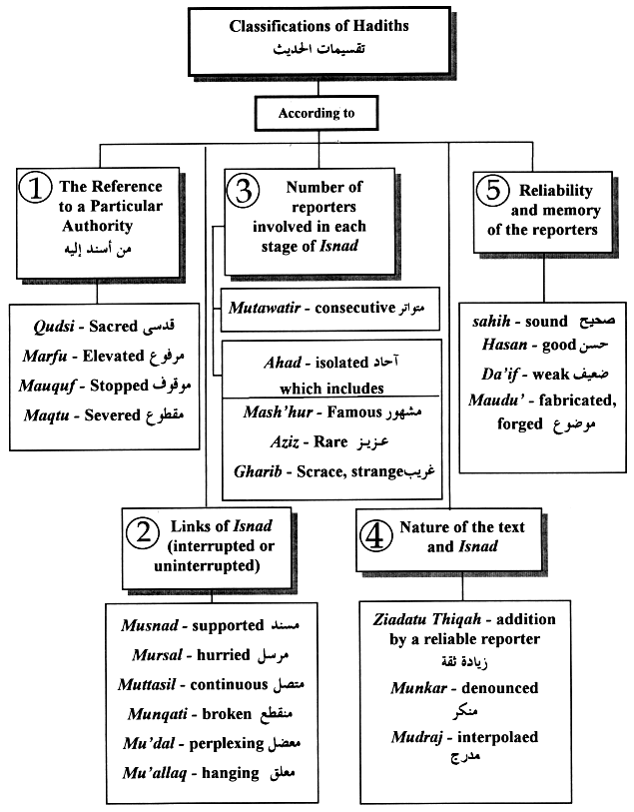
Hadith Classification

Slide 32
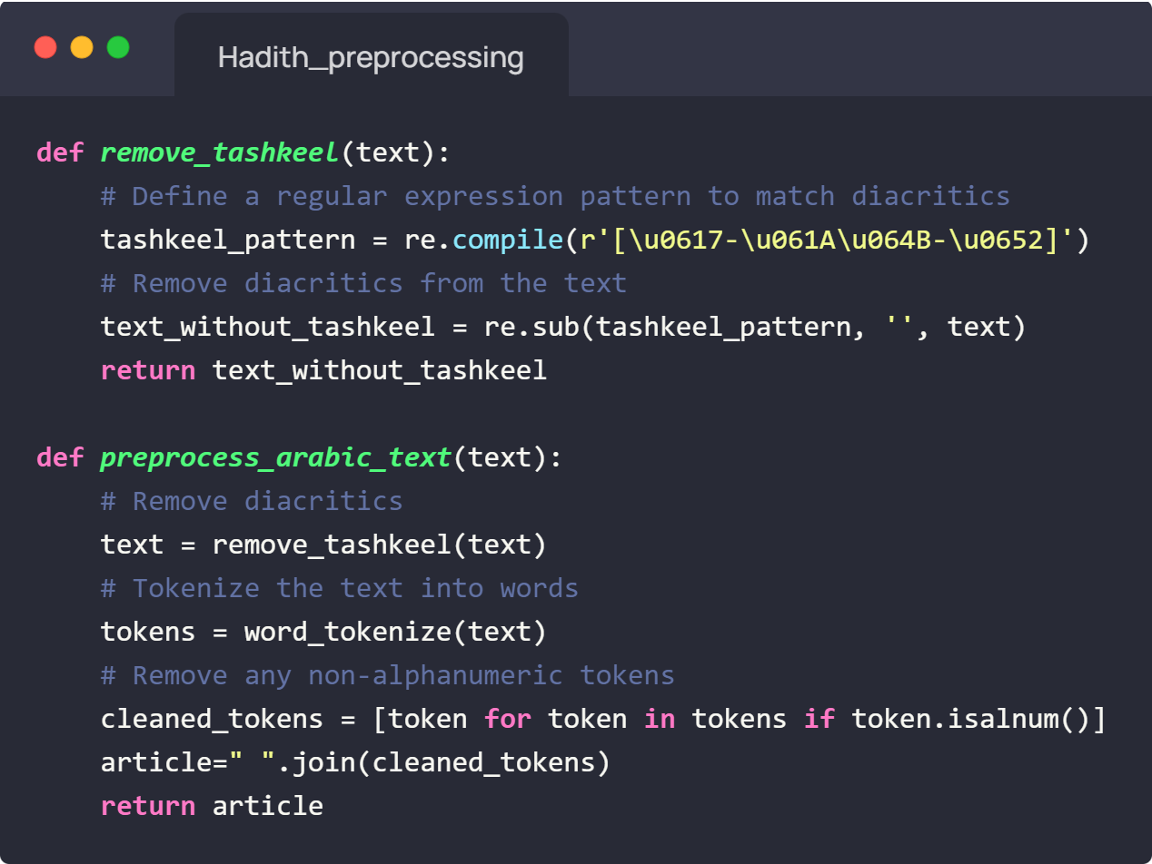
Hadith Classification
Data Preprocessing
character class [\u0617-\u061A\u064B-\u0652] to match Unicode ranges for tashkeel characters
Preprocess_arabic_text:
Removes tashkeel (calls remove_tashkeel)
Tokenizes text into words (using NLTK)
Removes non-alphanumeric tokens (punctuation, symbols)

Slide 33
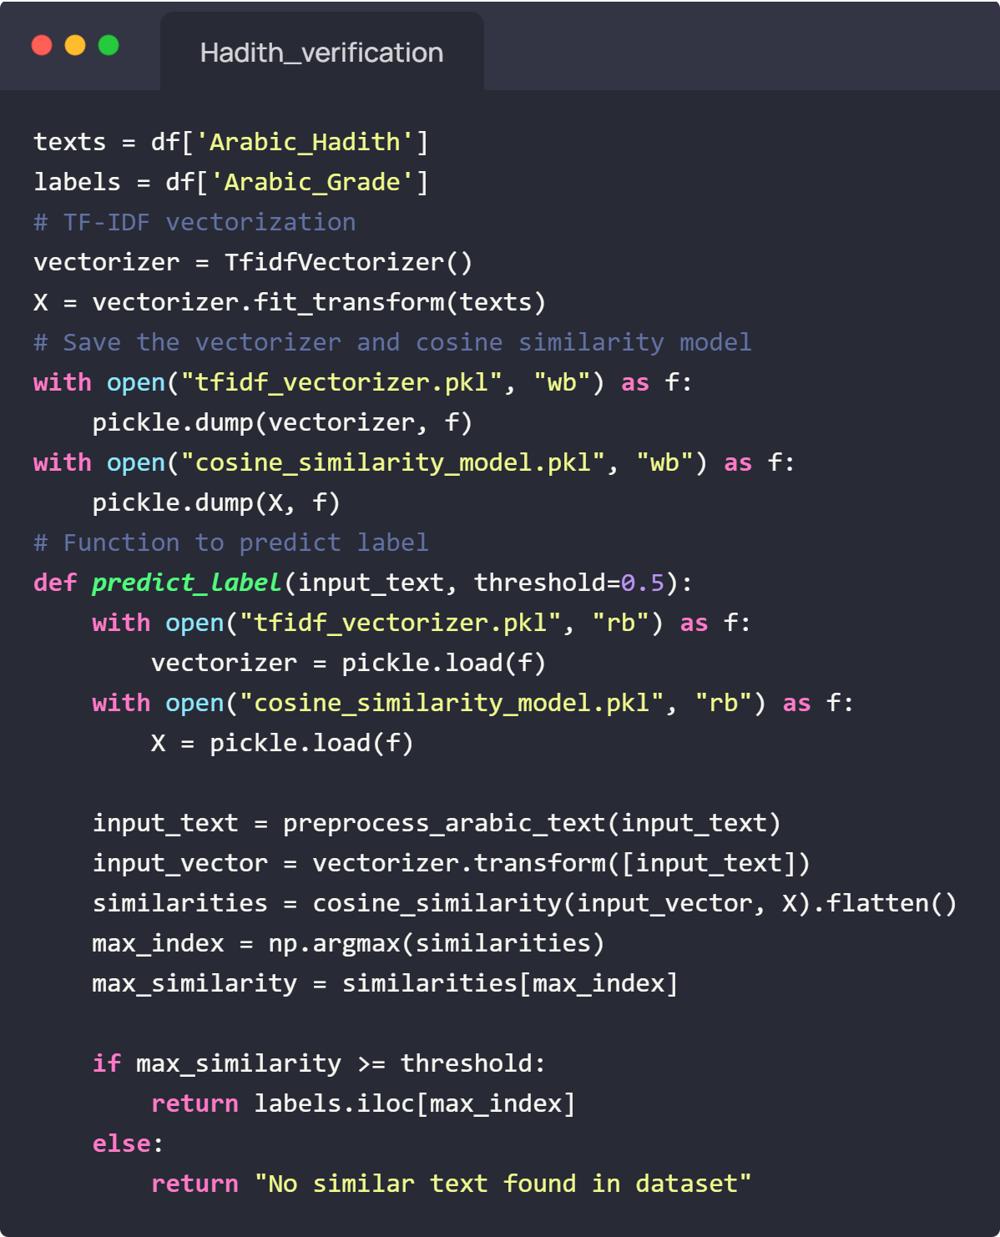
Hadith Classification
Prediction
TF-IDF vectorization creates document vectors
Cosine Similarity measures similarity between text documents
Cosine similarity compares the angles between vectors based on the cosine of the angle between two vectors

Slide 34
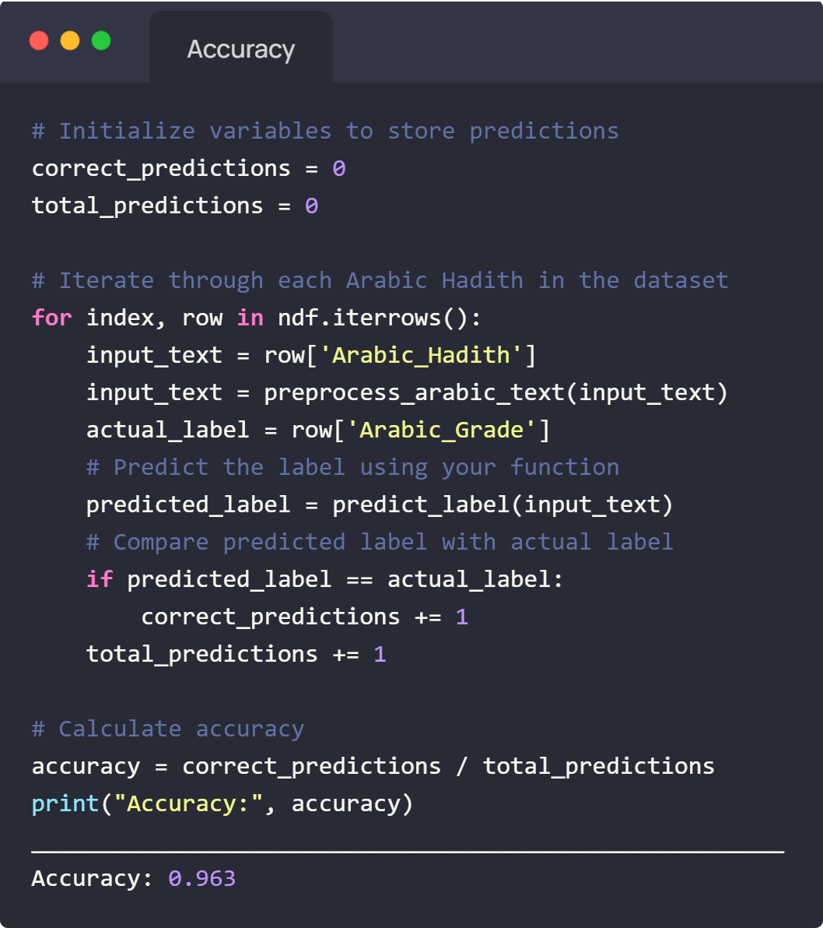
Hadith Verification
Accuracy
Evaluating Model Performance:
Initializing Variables
Iterating Through Data
Making Predictions
Counting All Predictions
Calculating Accuracy

Slide 35
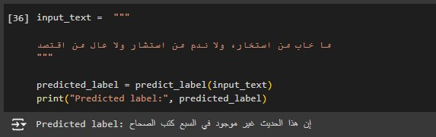
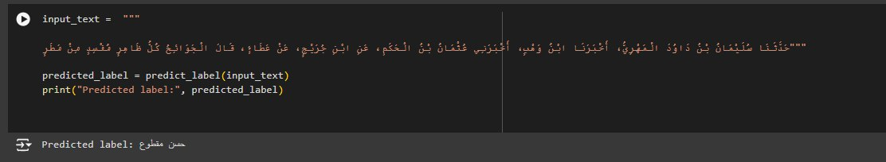
Hadith Classification
Outputs:

Slide 36
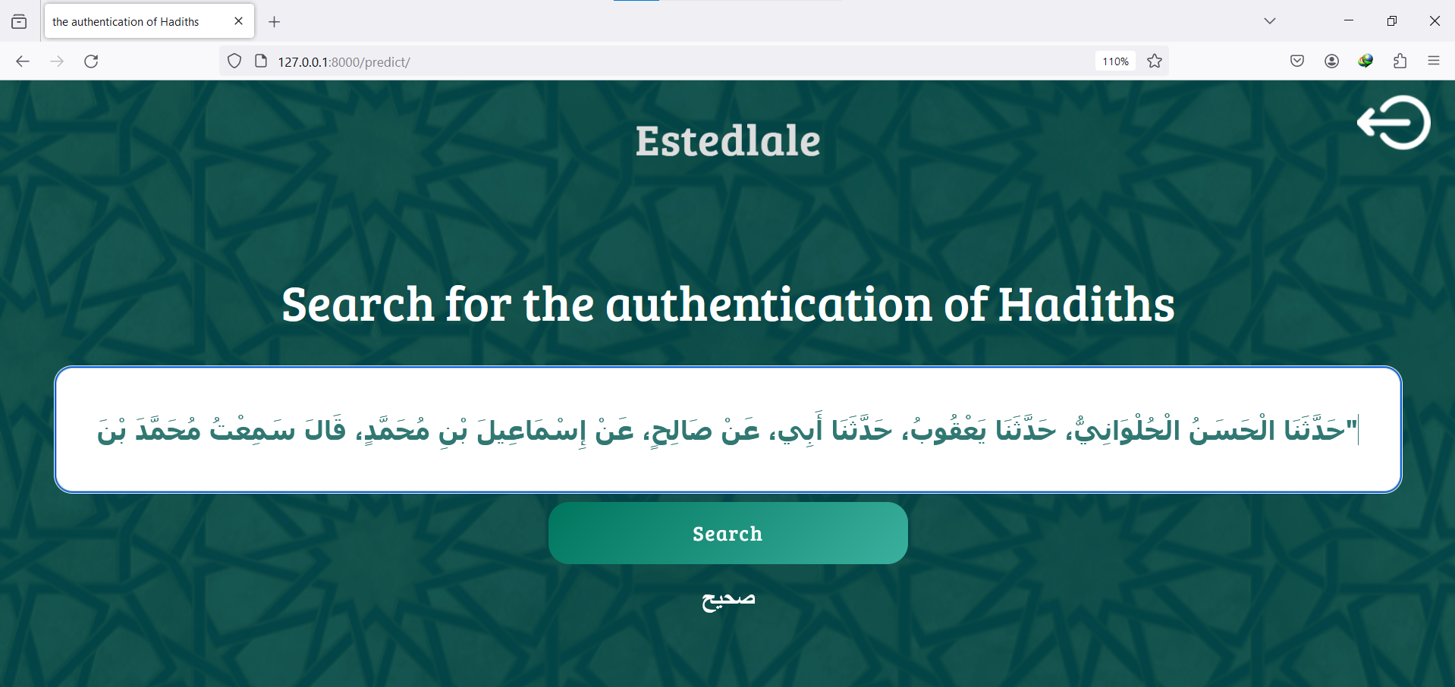
Hadith Classification Web View

Slide 37
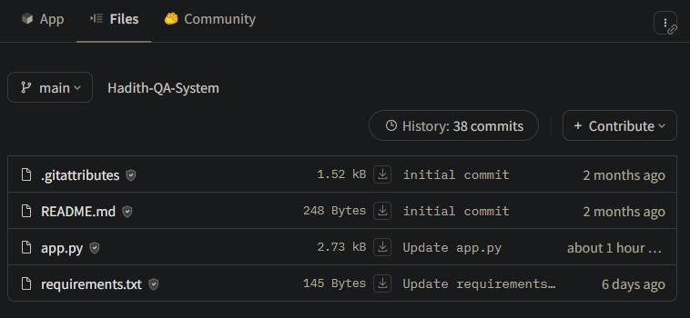
Deploy Using Hugging Face
Step-by-Step Deployment on Hugging Face:
Creating a Space: Navigate to Hugging Face Spaces and set up the environment for Gradio.
Adding Required Files: Include requirements.txt listing necessary packages. Add app.py, which built using OOP containing the HadithChat class for QDrant and Gemini interactions.
Notes:
What is Gradio?
Gradio is an open-source Python library that allows you to quickly create customizable UIs for your machine learning models.
Rapid Prototyping Made Easy
With Gradio, you can prototype and deploy ML models without needing to write any frontend code. It's all done in Python!
Key Features
Simple Interface: Gradio offers a simple, intuitive interface for designing UIs.
Customizable Components: Tailor your UIs with various components like sliders, text boxes, and dropdowns.
Real-Time Feedback: Instantly visualize model outputs as user
s interact with the interface.
Multiple Framework Support: Gradio supports TensorFlow, PyTorch, and other major ML frameworks.
Shareable Interfaces: Easily share your models by generating a link to your Gradio interface.
Use Cases
Research Prototyping: Quickly test and visualize models during research phases.
Education: Create interactive demonstrations for teaching ML concepts.

Slide 38
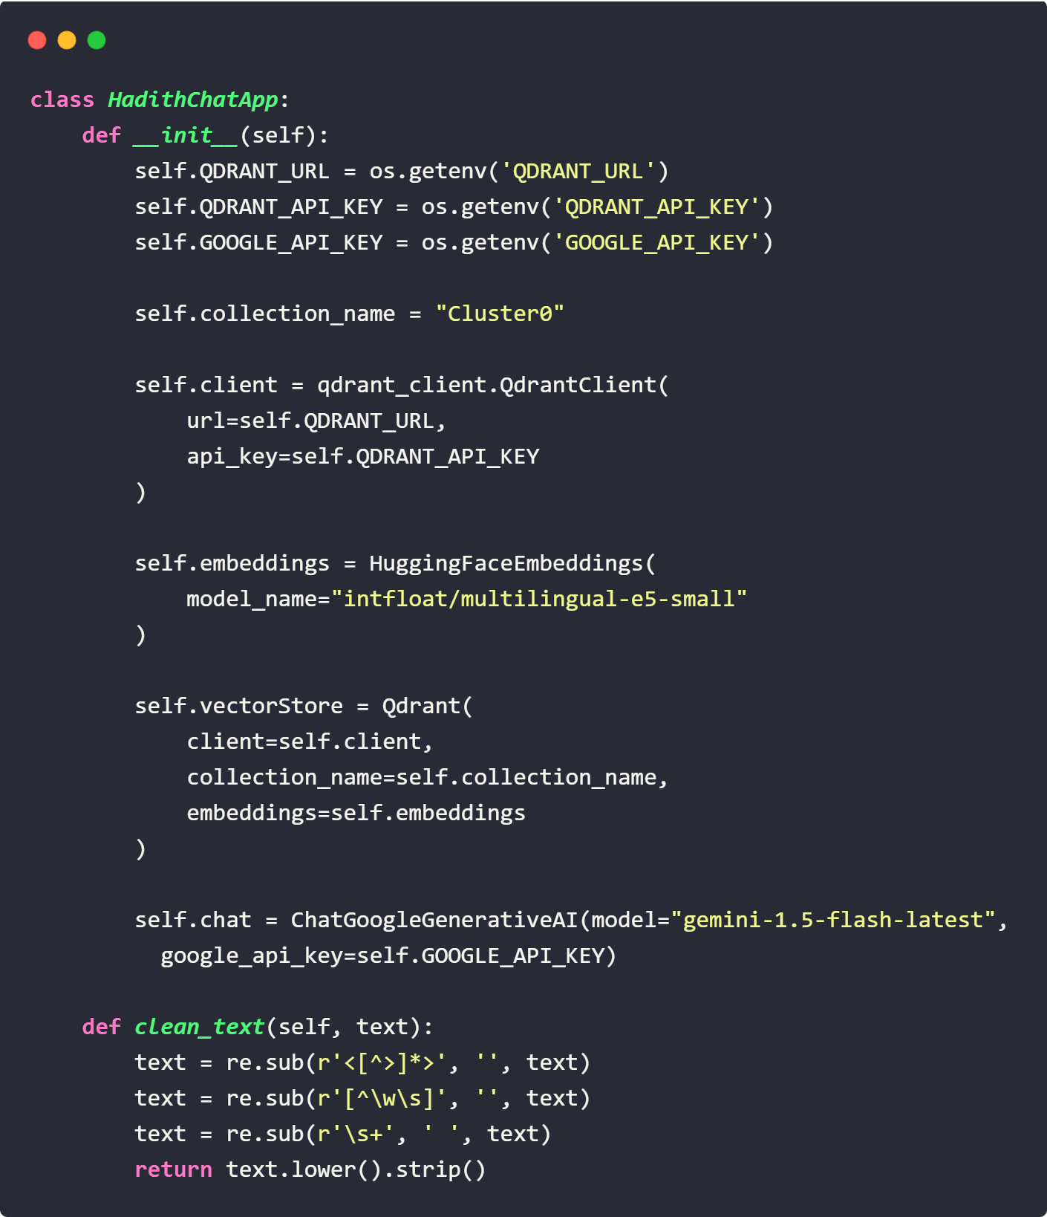
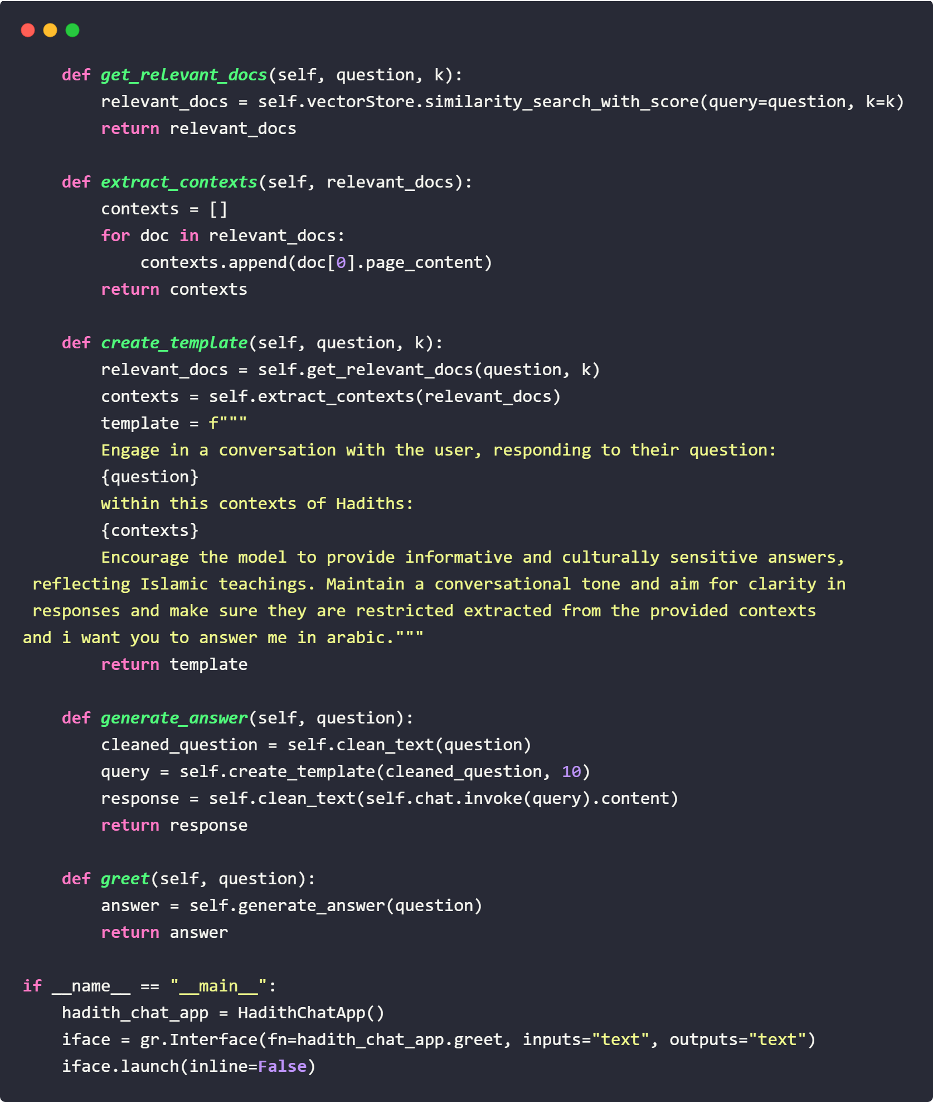

Slide 39
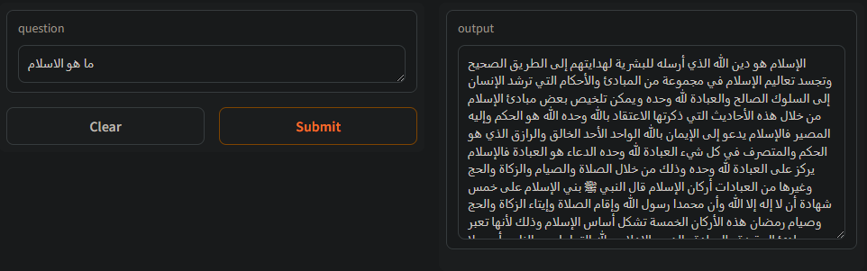
Examples
Question-Answer Interaction Example:

Slide 40




Implementation & Deployment
Hugging Face for Model Deployment: Hosted the Hadith QA RAG model on Hugging Face’s Model Hub.
Leveraged Inference API for scalable model predictions.
SQLite for Users Data: Lightweight, file-based database management system with Django ORM models.
Gradio for Simple UI: Developed a user-friendly, web-based interface.
Enabled real-time user interaction and display.
Django for Web: Built-in admin panel, ORM, and URL routing.

Slide 41
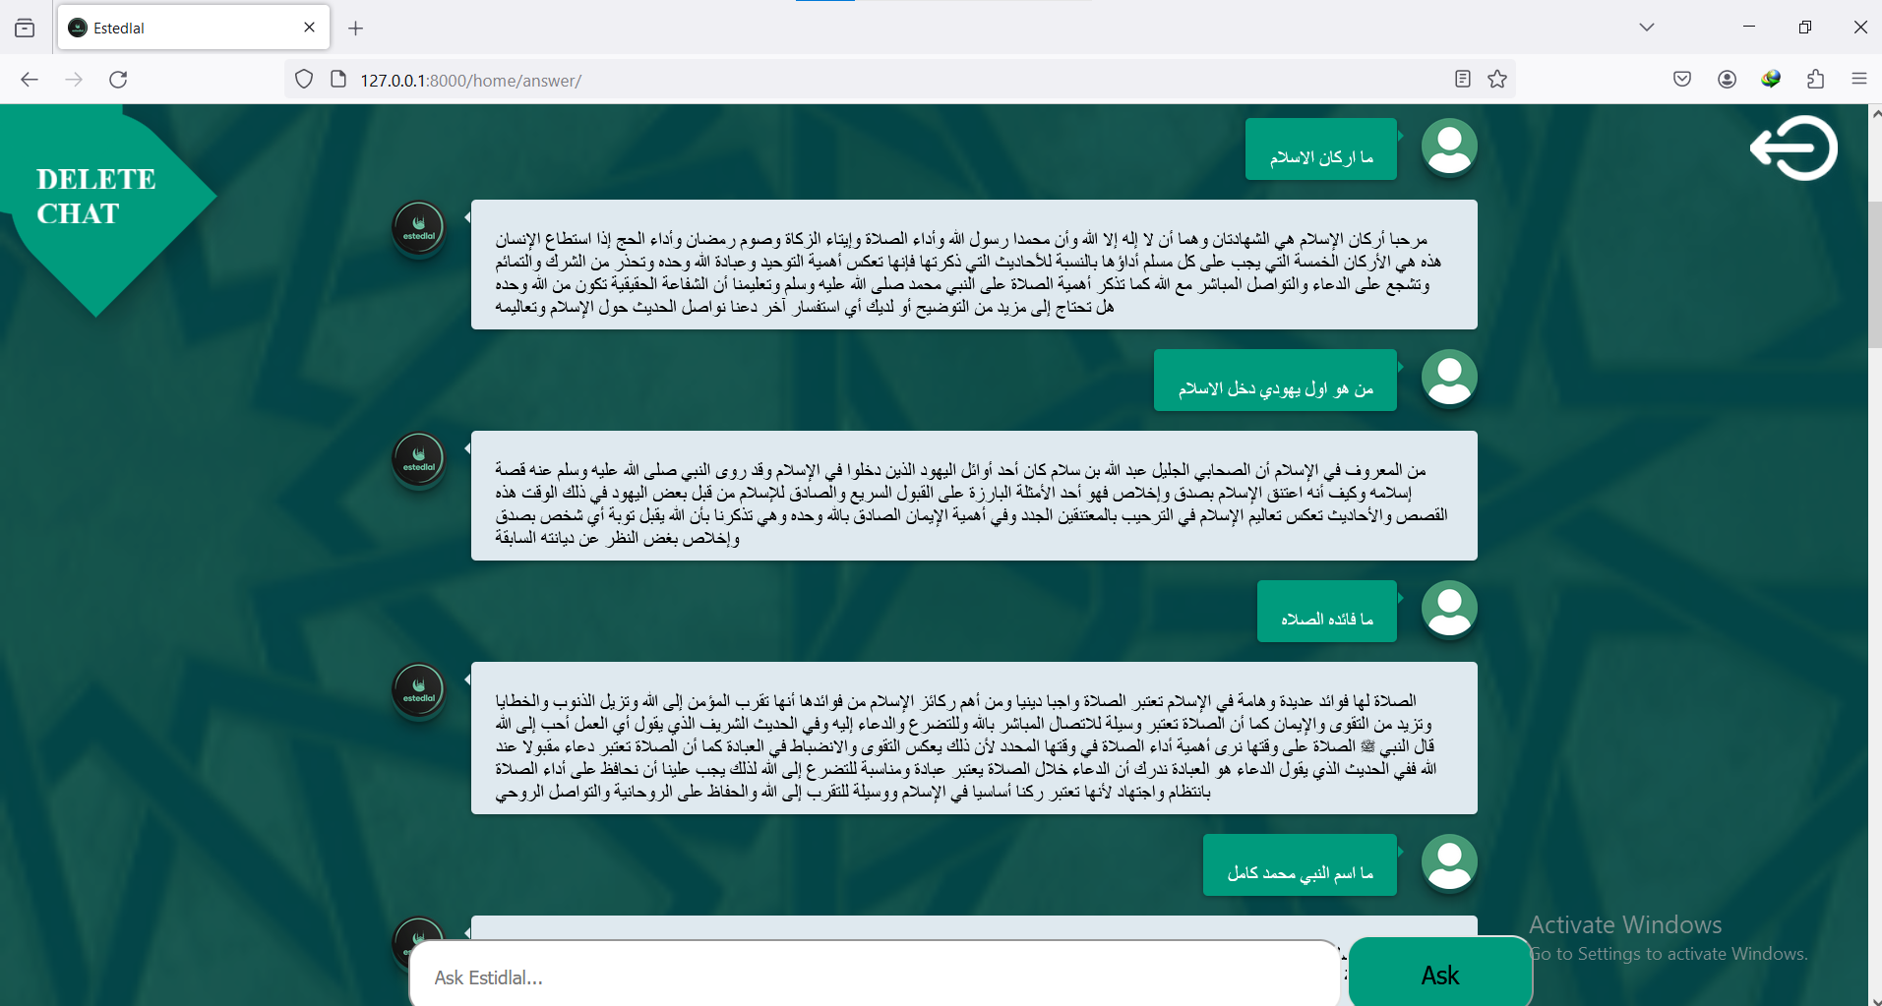
Hadith Chat Web View

Slide 42
Thanks

